Slide 1
Ansible F5 Network Workshop
Jim Garrett
Senior Solution Architect
jgarrett@redhat.com
September 2018

Slide 2
What You Will Learn
What is Ansible, its common use cases
How Ansible works and terminology
Running Playbook Basics
Network Modules
An Introduction to Roles
An Introduction to Ansible Galaxy

Slide 3
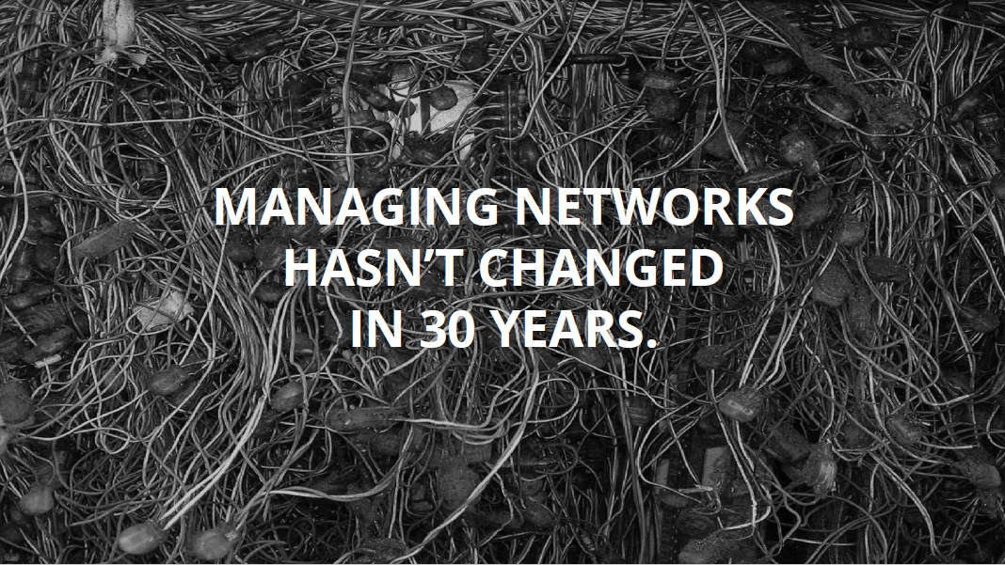

Slide 4
Managing networks hasn’t changed in 30 years
Networks are mission critical
Every network is a unique snowflake
Ad-hoc changes that proliferate
Vendor specific implementations
Testing is expensive/impossible

Slide 5
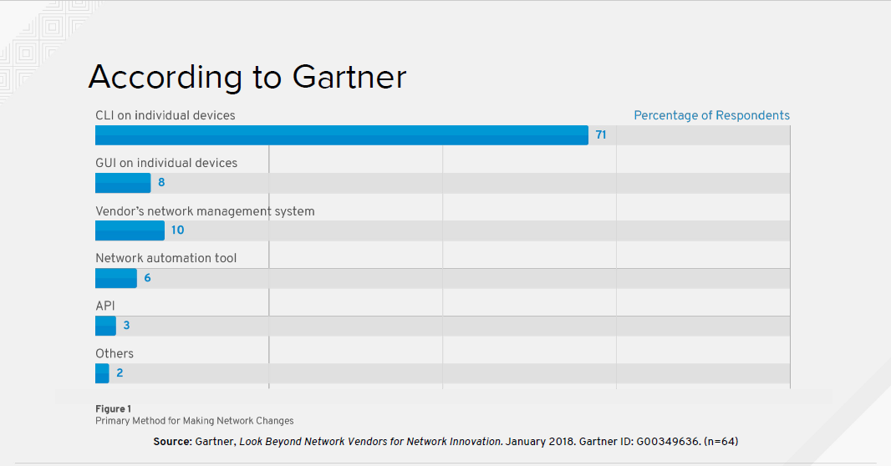
Notes:
Primary method for Making Network Changes
It’s important to note that 71% of network vendors manage their products using Command Line Interfaces

Slide 6
Automatic considerations
Compute is no longer the slowest link in the chain
Businesses demand that networks deliver at the speed of cloud
Automation of repeatable tasks
Bridge silos
Notes:
With the creation of the cloud demand has skyrocketed for faster delivery
Business’s demand that network configuration become a consistent, repeatable automatable process
To meet this need, vendors are turning to Ansible to provide automation at the Network level
In fact, many of the top network vendors are contributing back upstream into the Ansible source code tree, providing new modules that can be used to manager their products

Slide 7
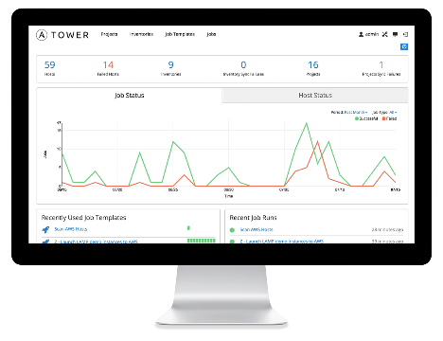
WHAT IS ANSIBLE?
It’s an automation engine - Ansible
Automate What????

Slide 8

WHAT IS ANSIBLE?
Automation Engine
IT Infrastructure
Networks - F5, Arista, Cisco,
Juniper, Open Vswitch
VYOS, others

Slide 9
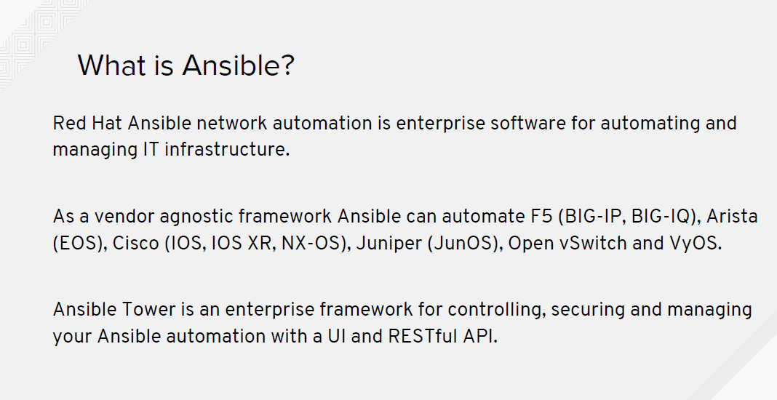

Slide 10
WHAT IS ANSIBLE?
It’s an automation engine - Ansible
It’s an automation language - Ansible Playbooks.
Enterprise framework for controlling, securing and managing your automation – Ansible Tower

Slide 11
SIMPLE
POWERFUL
Agentless
Human readable automation
No special coding skills needed
Tasks executed in order
Get productive quickly
Configuration management
App deployment
Workflow orchestration
Orchestrate the app lifecycle
Agentless architecture
Uses OpenSSH & WinRM
More efficient & more secure

Slide 12
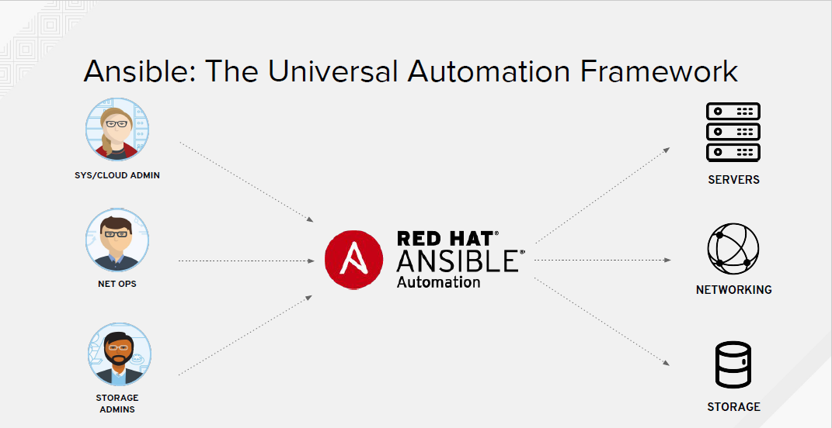
Notes:
Ansible is THE Universal Automation Framework that can be used to automate the provisioning and configuration of SERVERS, NETWORKS and STORAGE

Slide 13
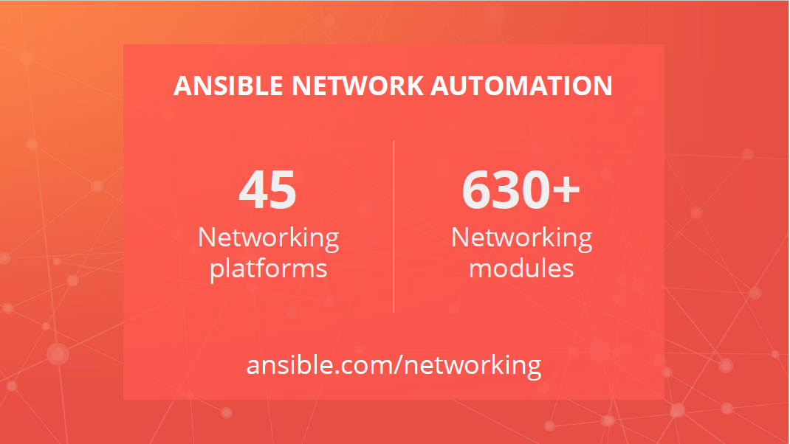

Slide 14
Common Use Cases
Anything an operator can do manually, Ansible can automate
Backup and restore device configurations
Upgrade network device OS
Ensure Configuration Compliance
Apply patches to address CVE (Common Vulnerabilities and Exposures)
Generate dynamic documentation

Slide 15
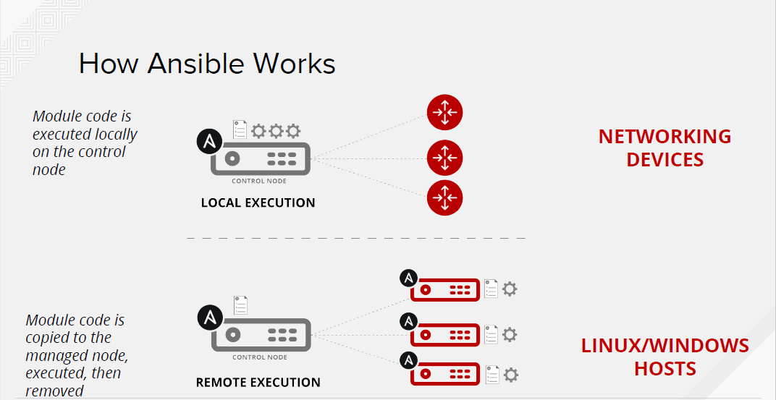

Slide 16
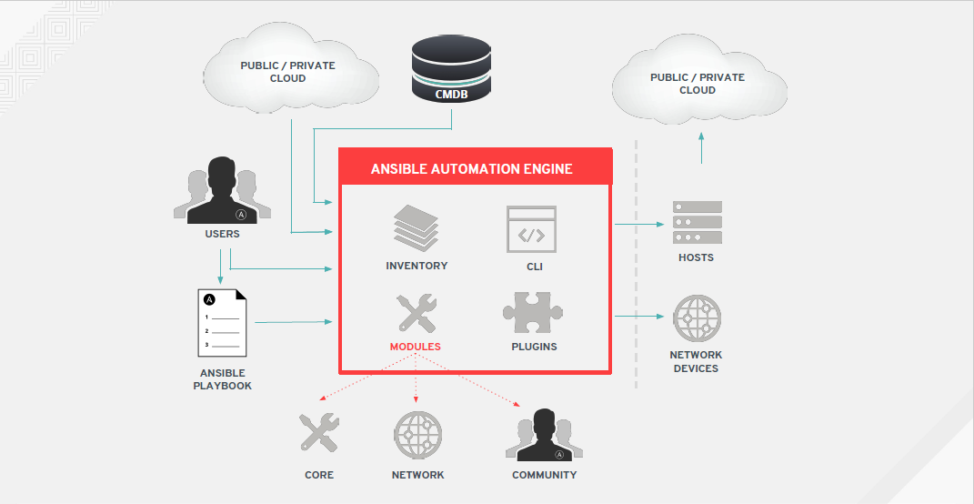

Slide 17
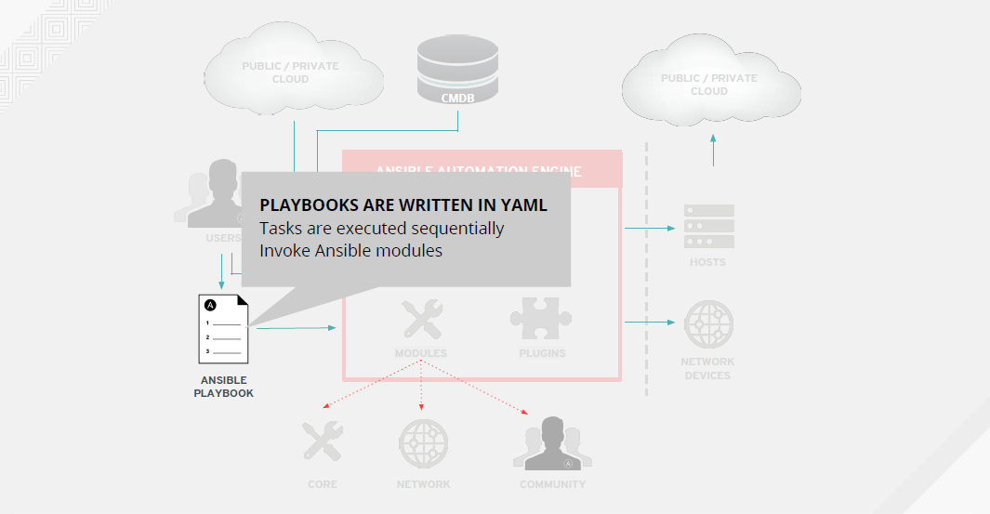

Slide 18
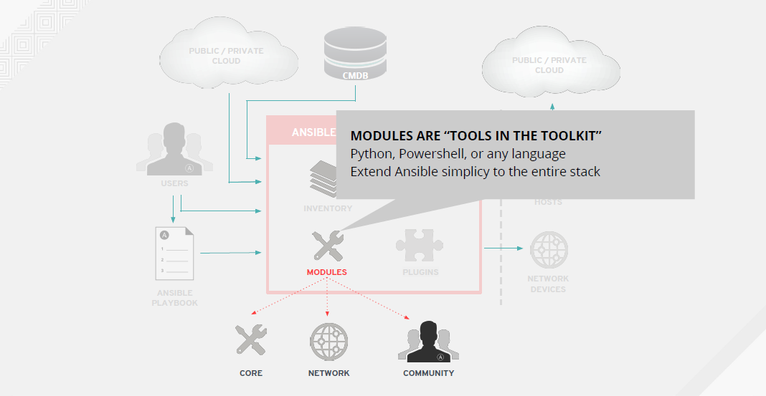

Slide 19
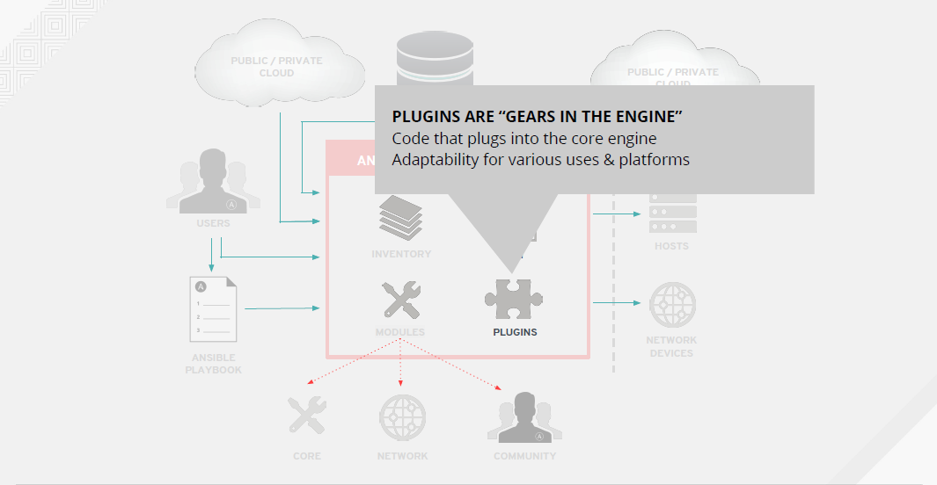

Slide 20
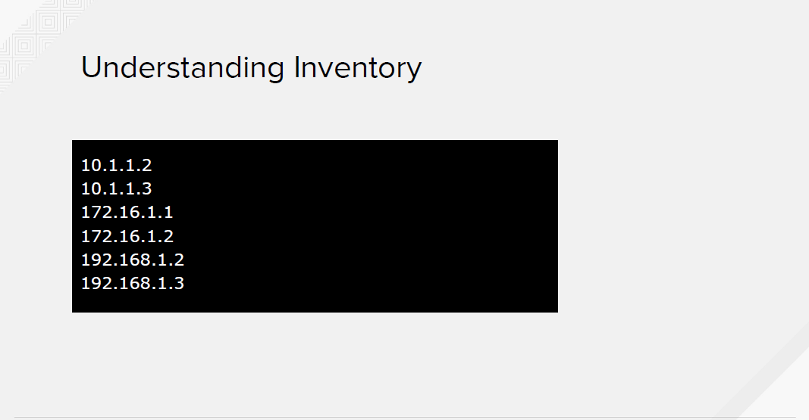
Notes:
Inventory consists of the list of servers that the Playbook will act upon. The servers can be either a simple IP Address or a fully qualified hostname

Slide 21
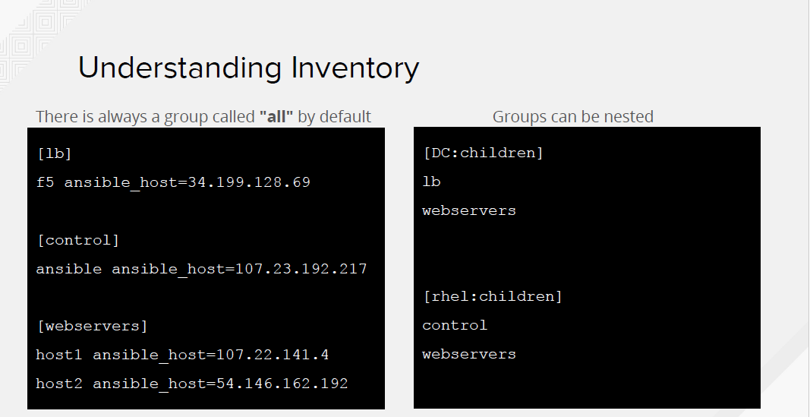

Slide 22
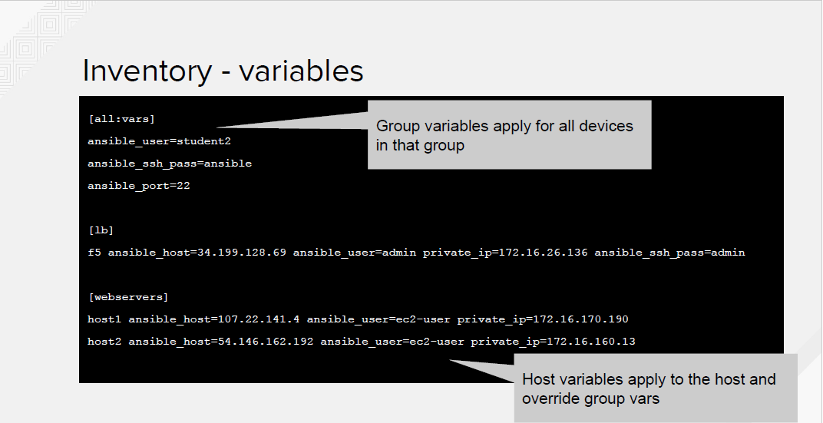

Slide 23
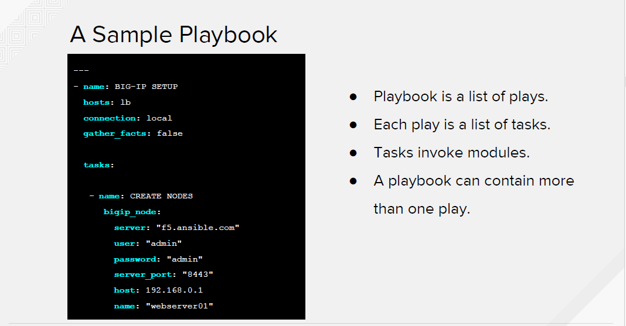

Slide 24
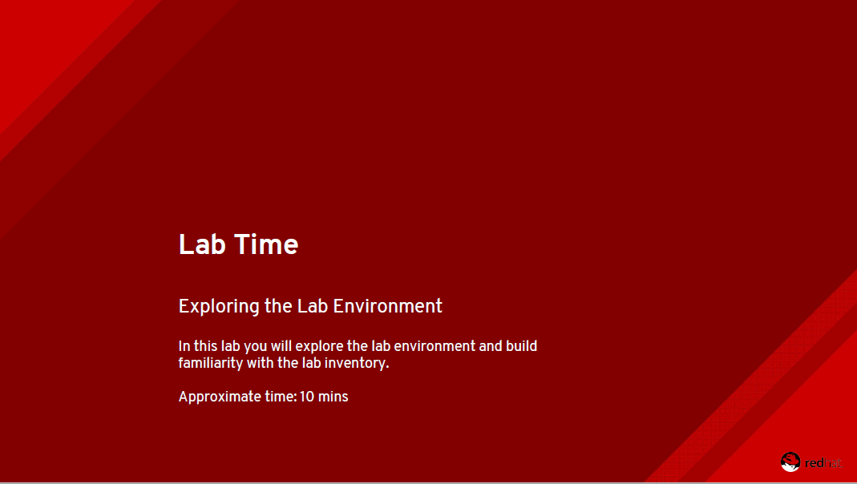

Slide 25
Lab Location
https://s3.amazonaws.com/ansible-f5.rhdemo.io/ansible-f5-index.html

Slide 26
Playbook definition for network automation
Target play execution using hosts
Define the connection: local
About gather_facts

Slide 27
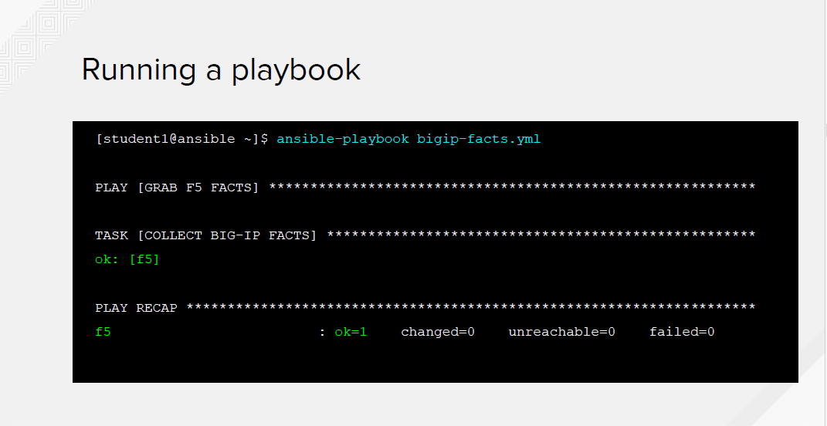

Slide 28
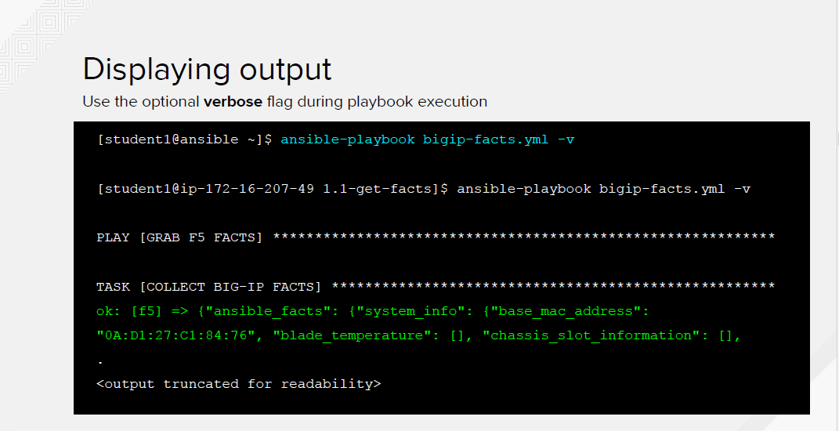

Slide 29
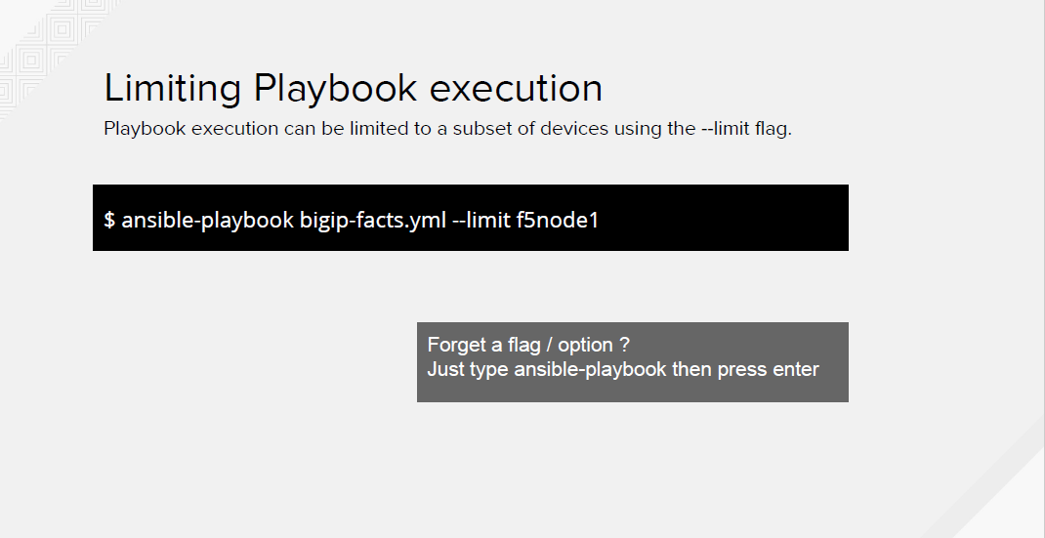

Slide 30
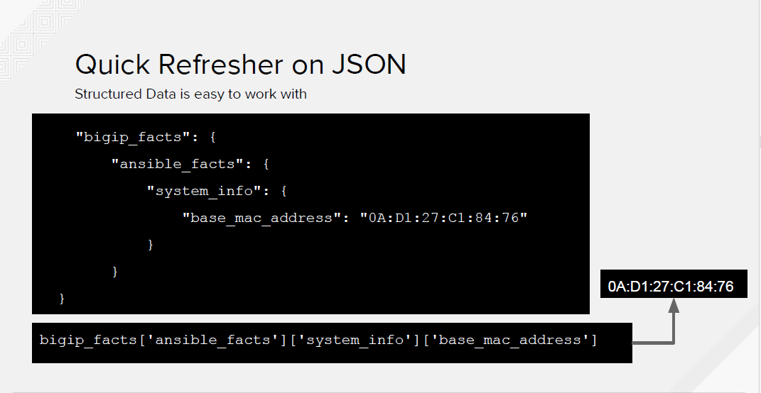

Slide 31
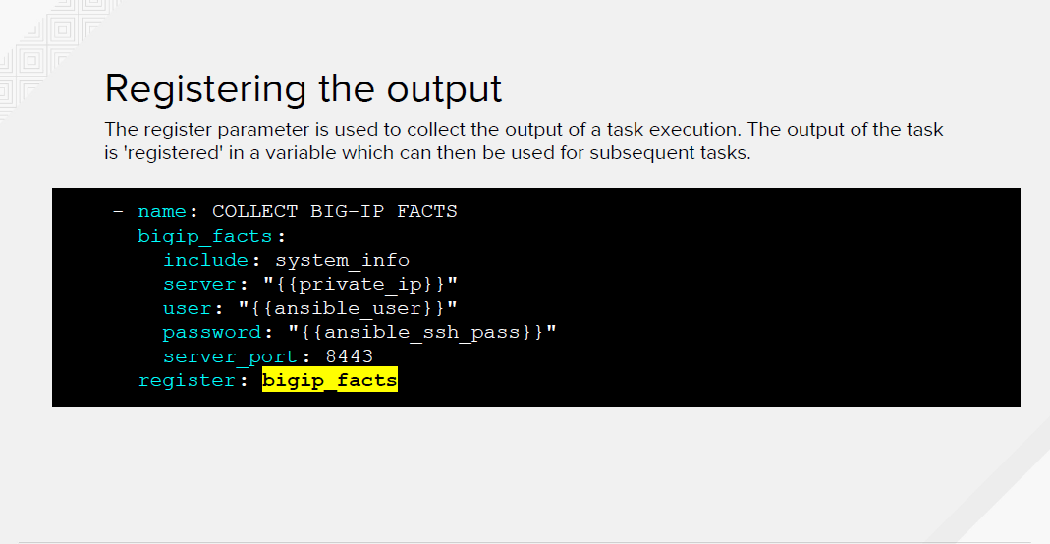

Slide 32
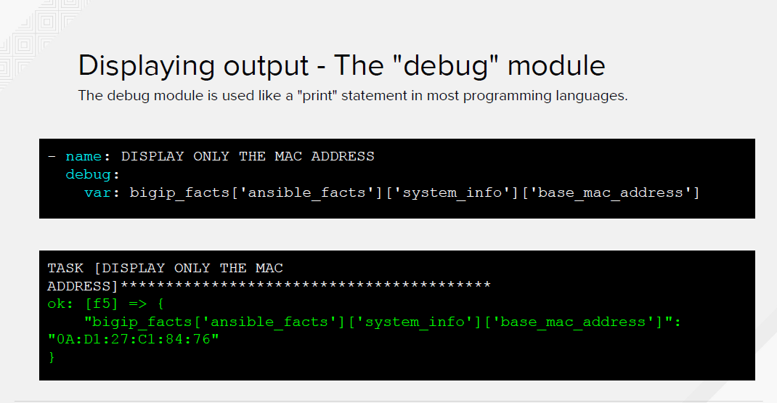

Slide 33
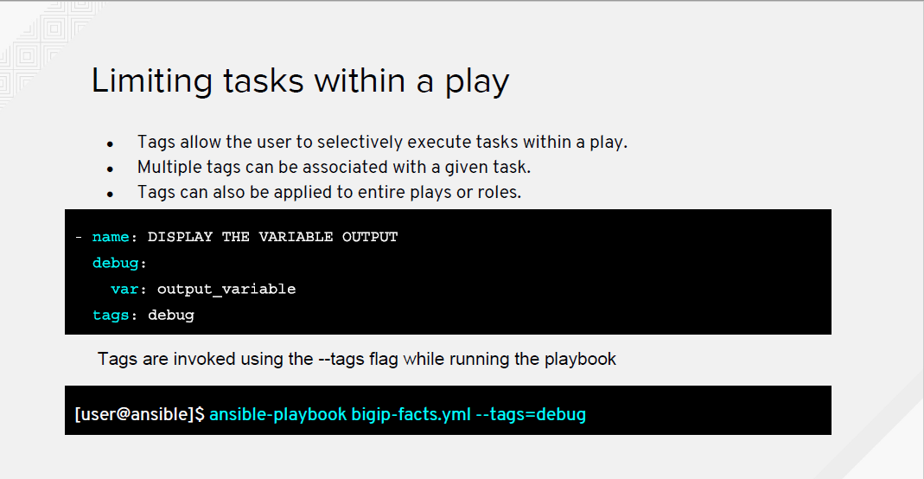

Slide 34
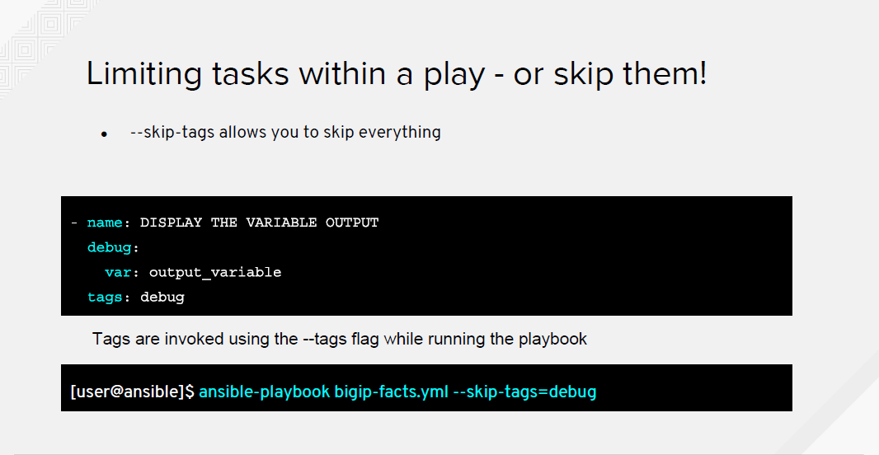

Slide 35
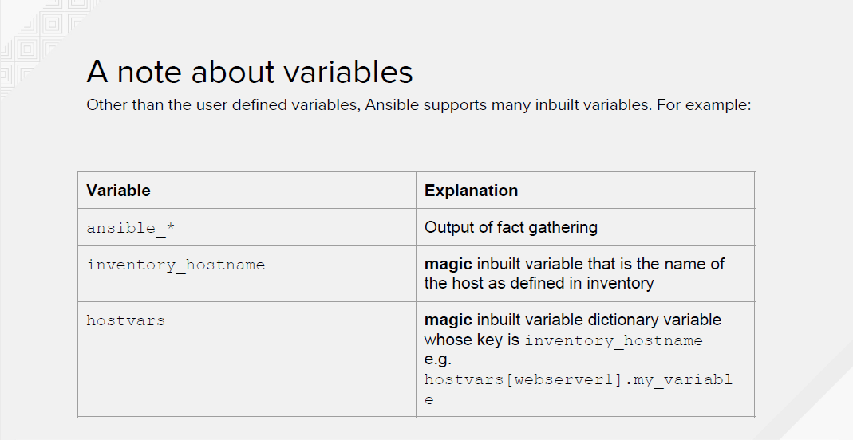

Slide 36
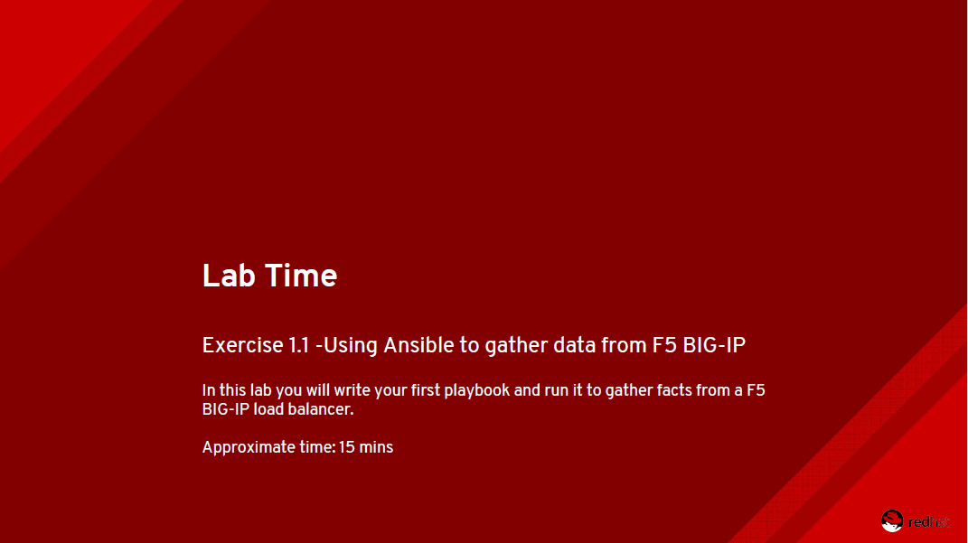

Slide 37
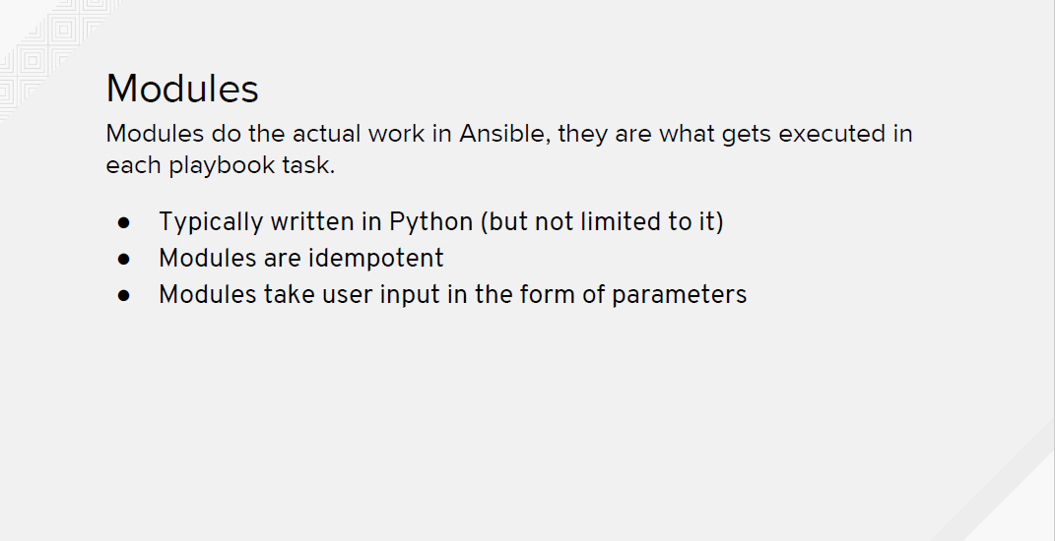
Notes:
Idempotent implies the object doesn’t change when operated upon by itself

Slide 38
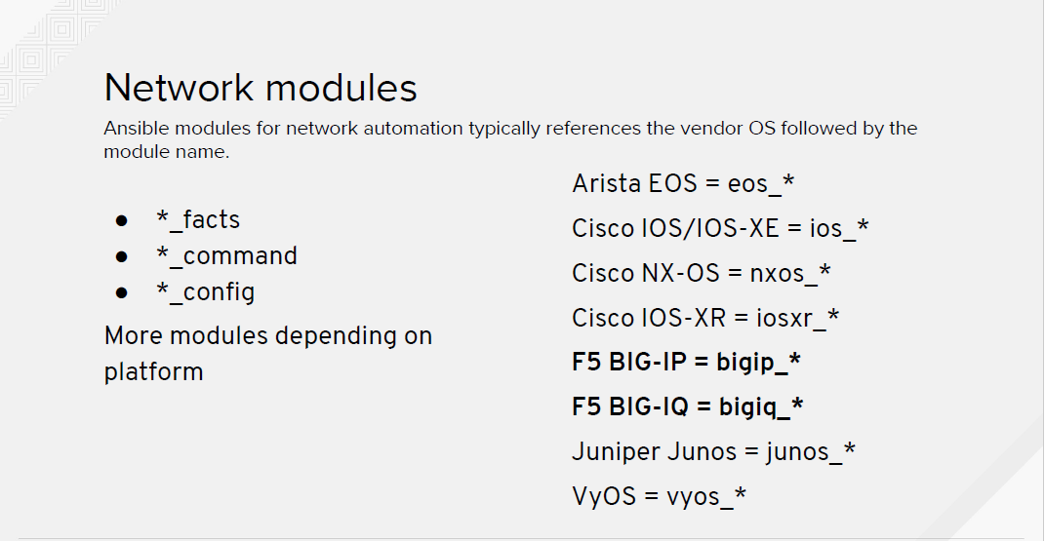

Slide 39
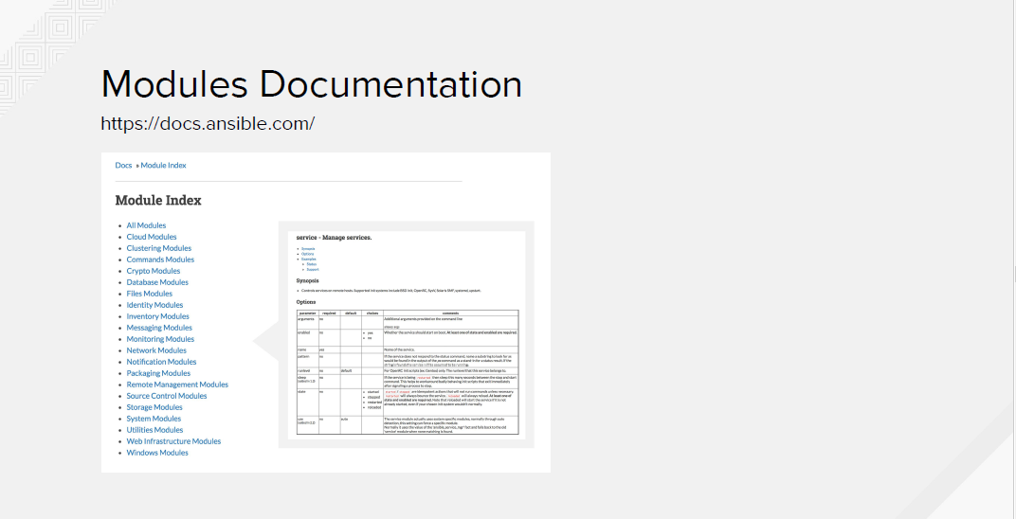

Slide 40
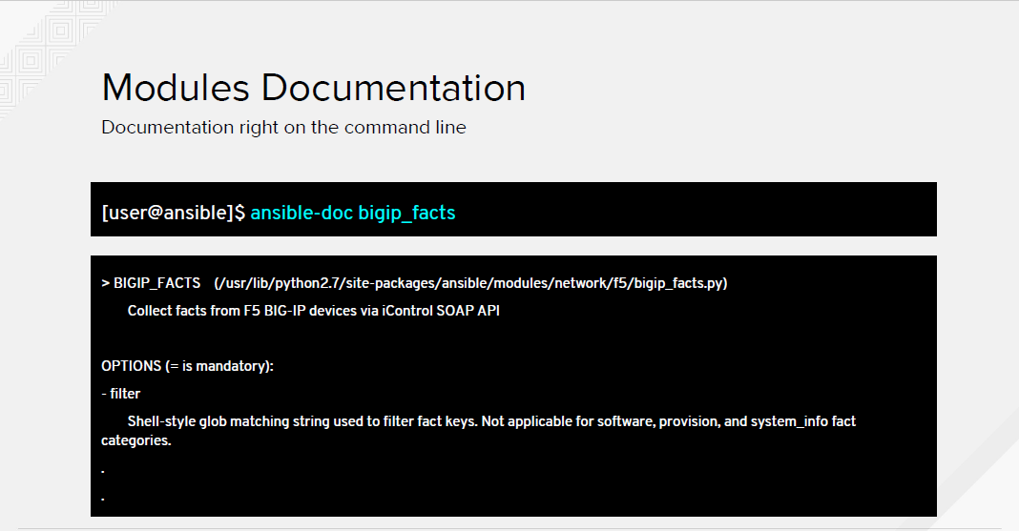

Slide 41
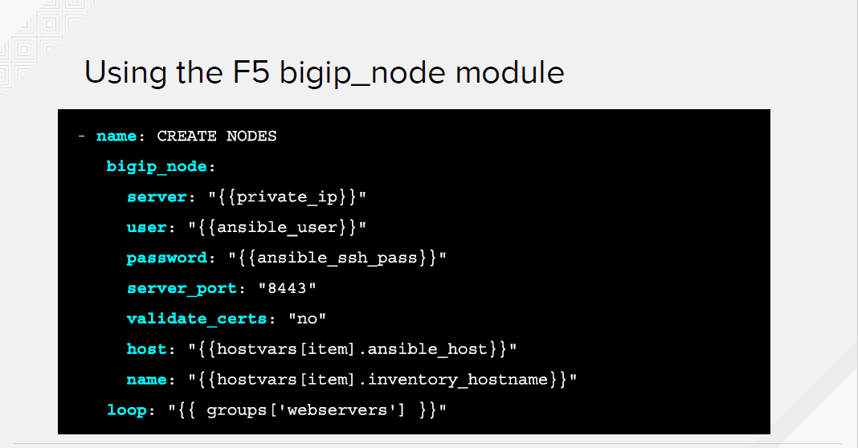

Slide 42
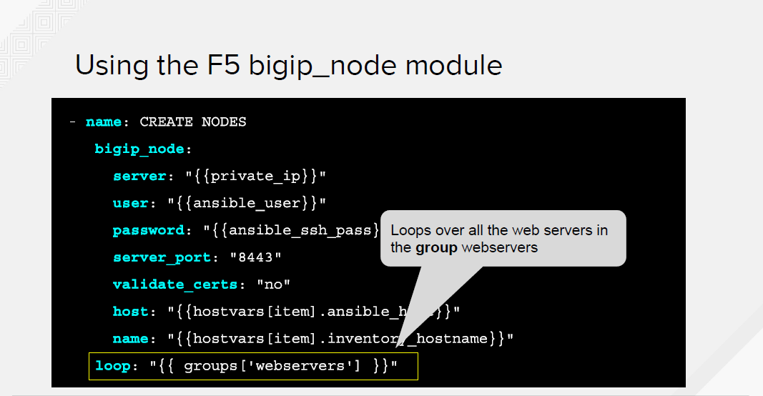

Slide 43
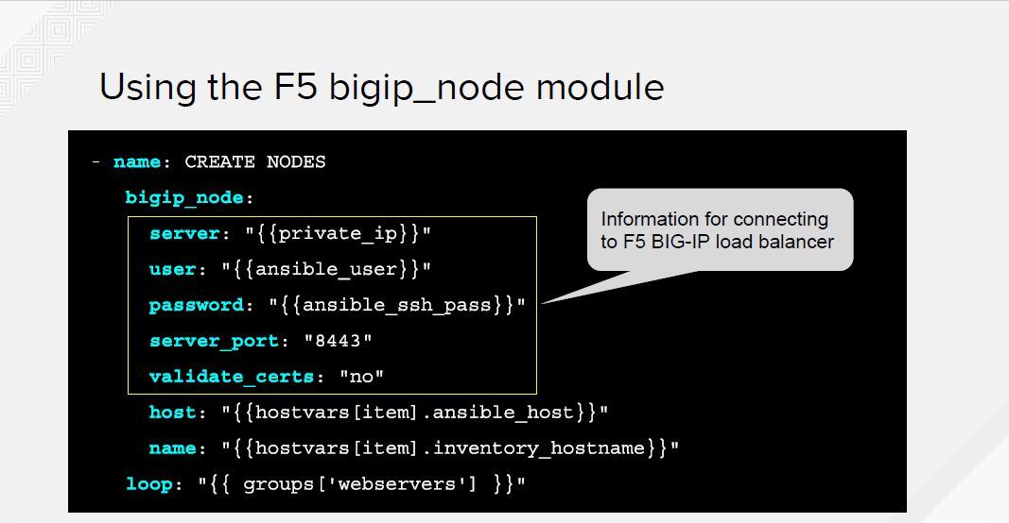

Slide 44
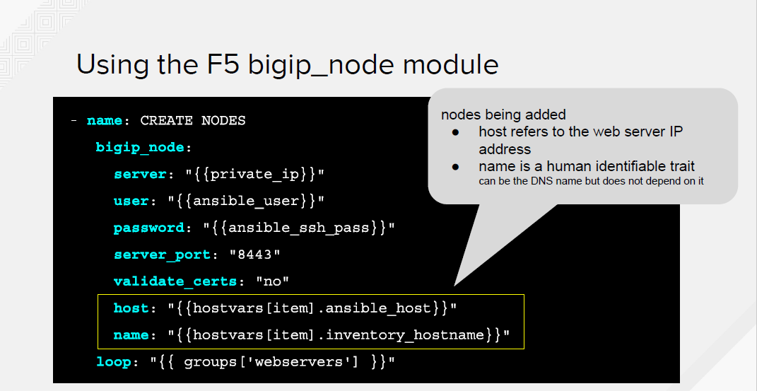

Slide 45
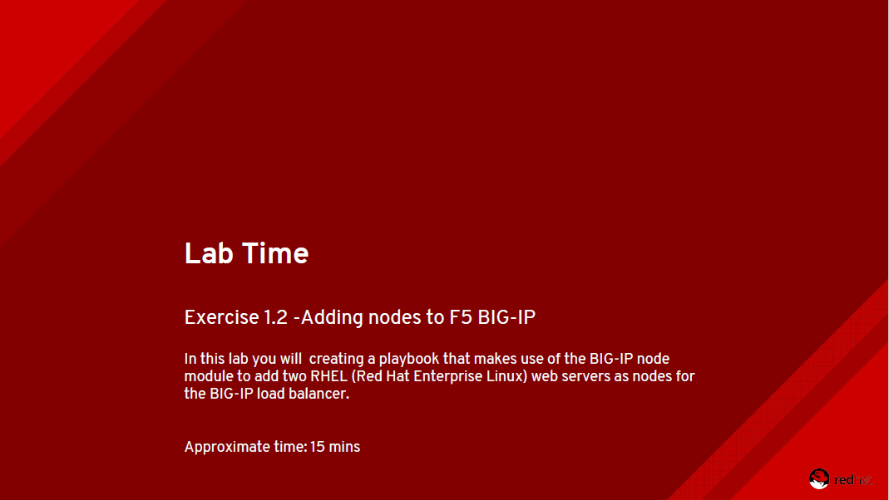

Slide 46
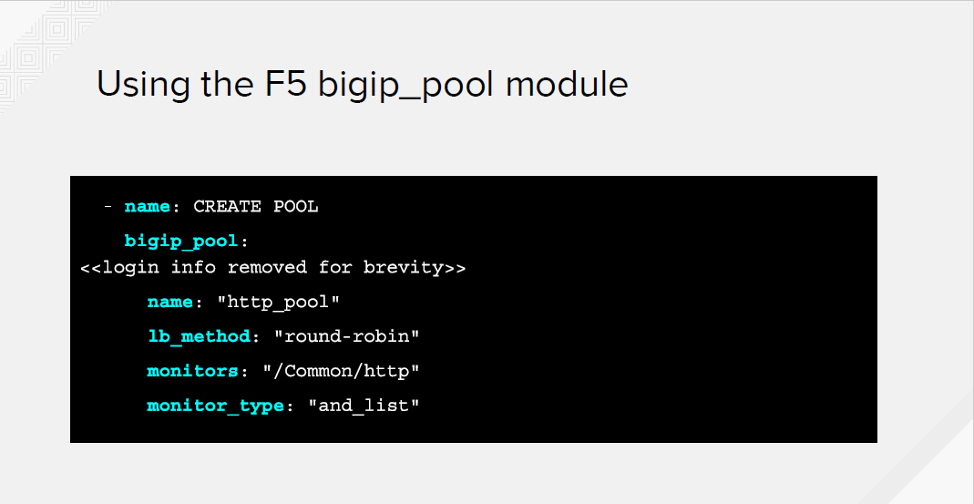

Slide 47
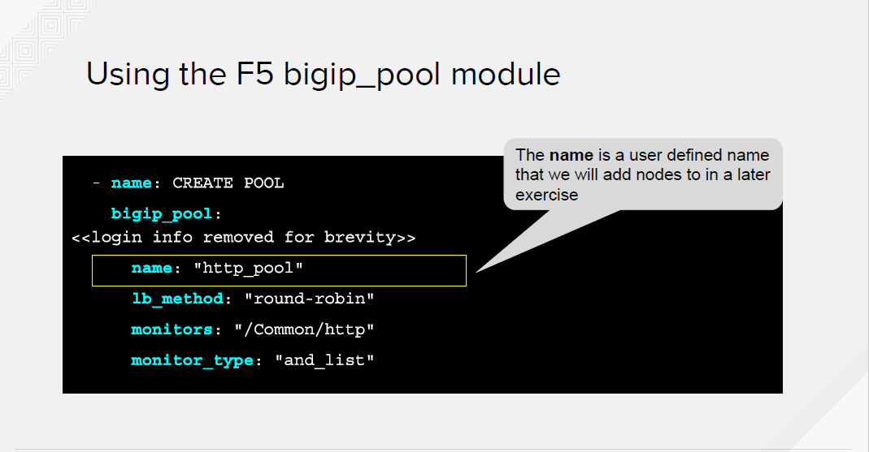

Slide 48
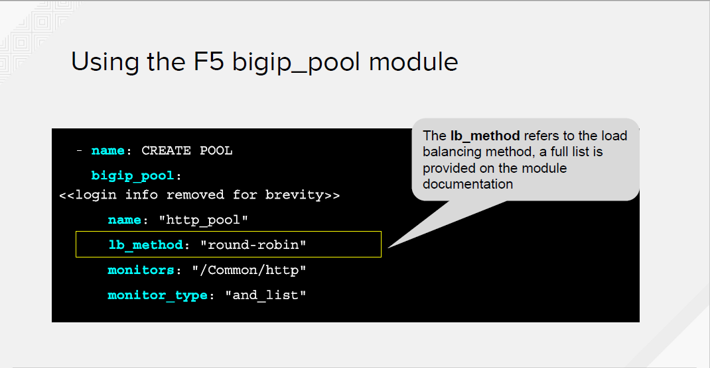

Slide 49
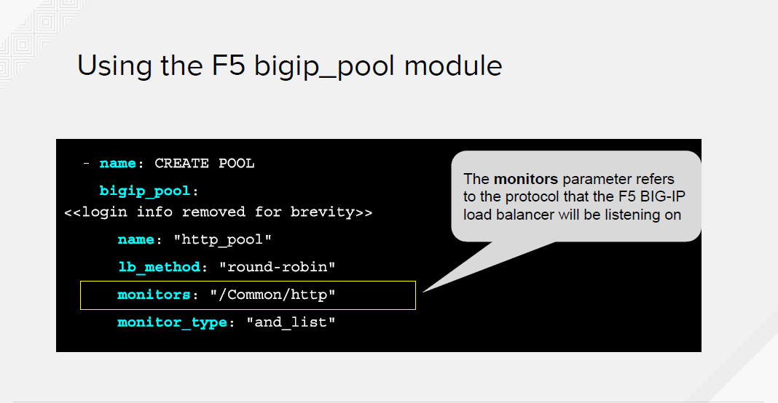

Slide 50
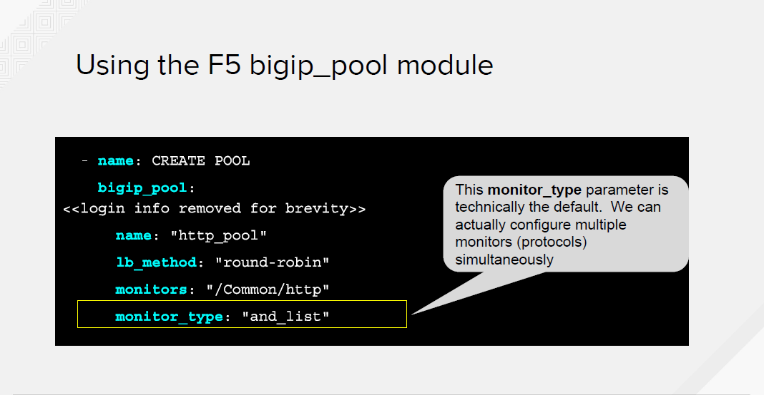

Slide 51
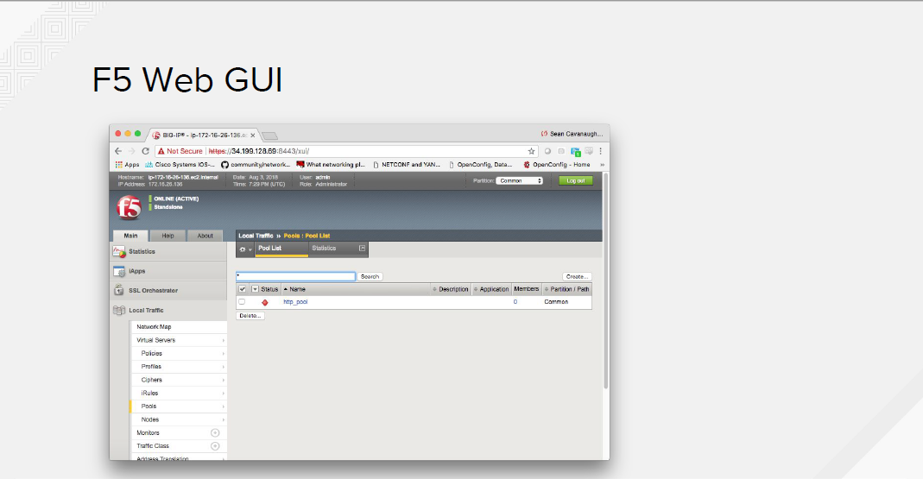

Slide 52
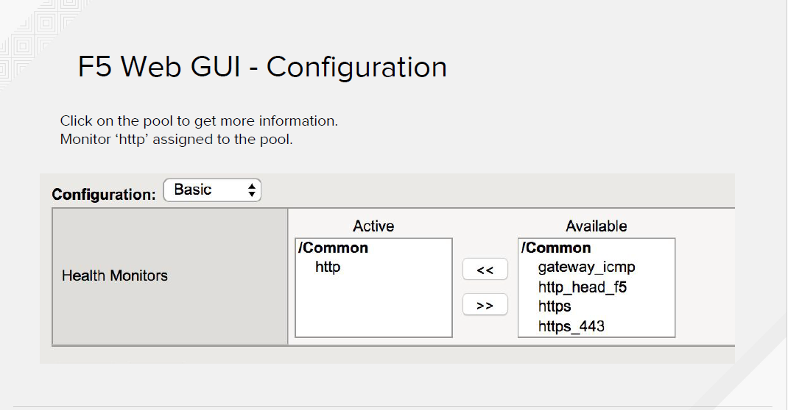

Slide 53
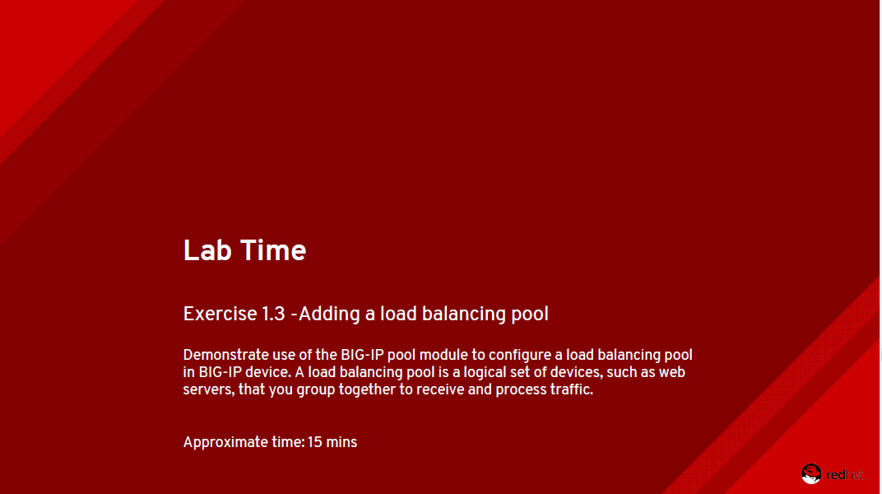

Slide 54
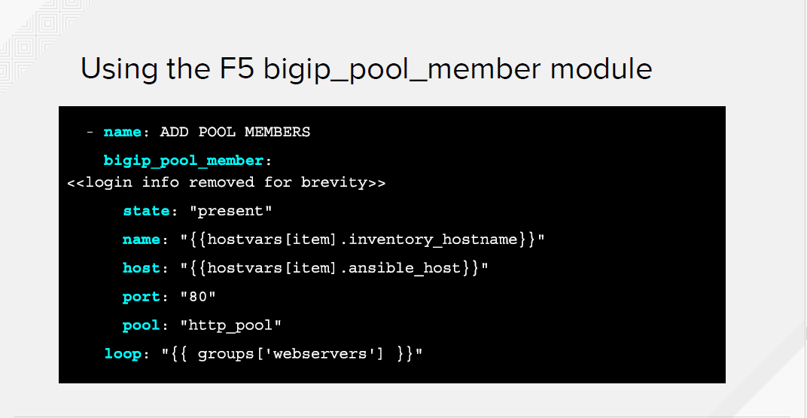

Slide 55
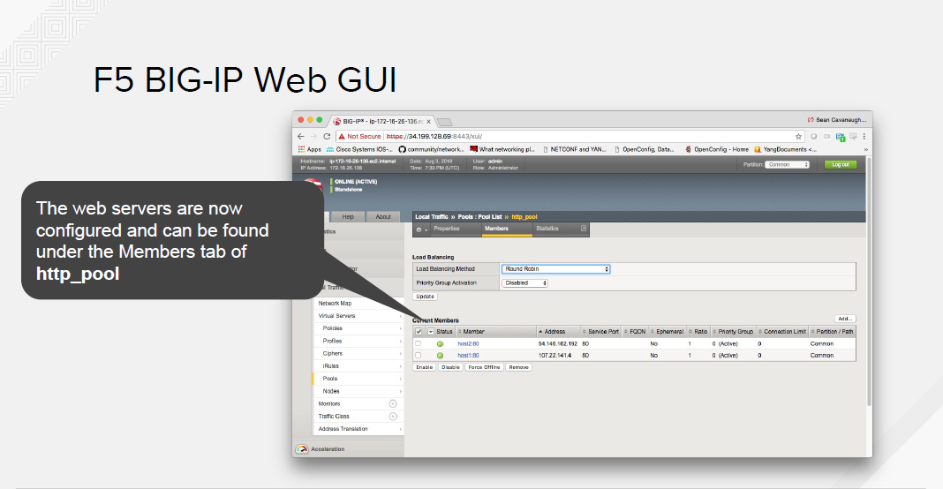

Slide 56
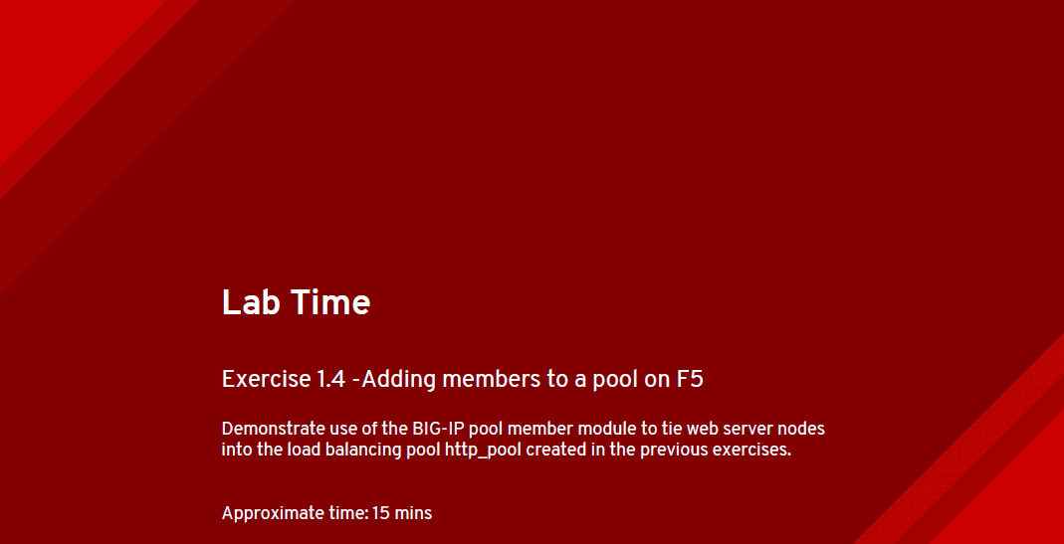

Slide 57
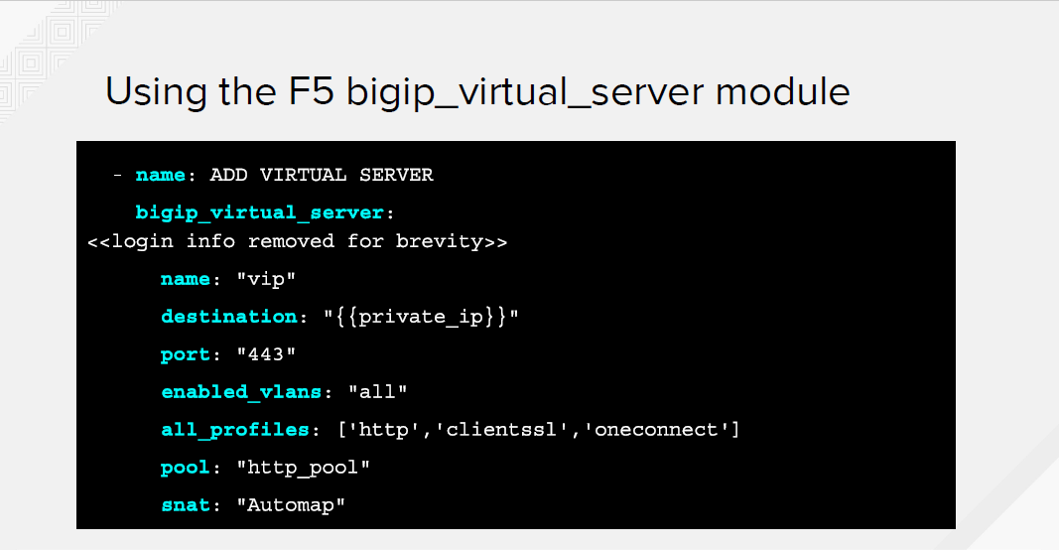

Slide 58
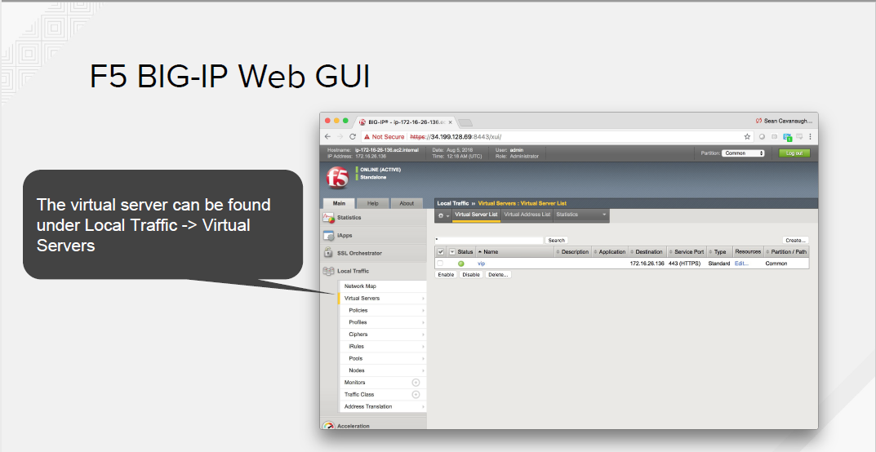

Slide 59
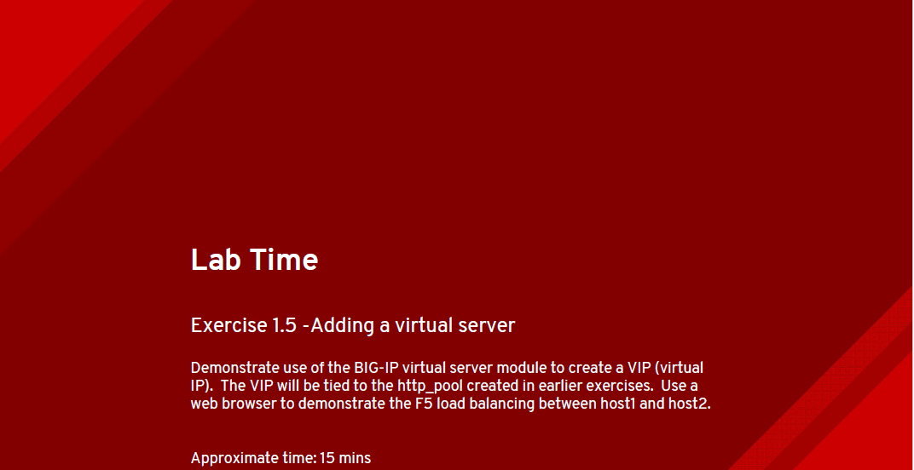

Slide 60
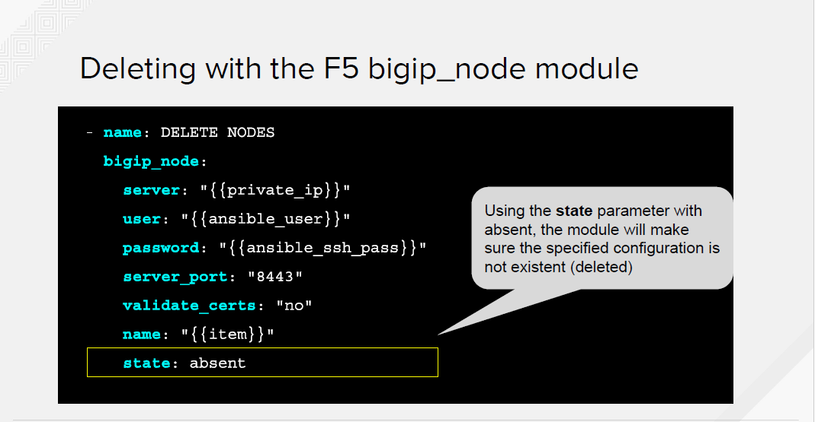

Slide 61


Slide 62


Slide 63


Slide 64


Slide 65


Slide 66


Slide 67


Slide 68


Slide 69


Slide 70


Slide 71


Slide 72


Slide 73


Slide 74


